Slide 1
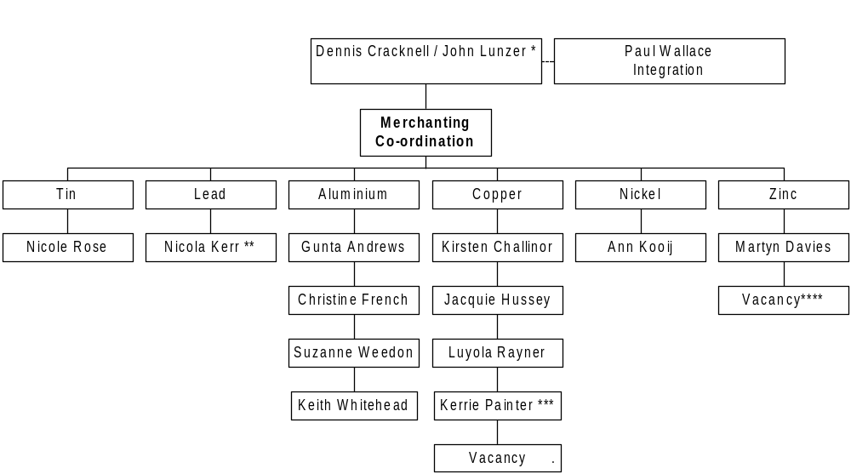
Enron Metals
Co-ordination
Enron Metals
New York
To be Agreed
Notes:
* Dennis for Ali and Tin, and John for Copper, Nickel and Zinc
** Nicola Kerr is designated L/C co-ordinator for the group
*** Kerrie Painter is on maternity leave from 1st October
**** Flexible cover for Tin, Nickel and Zinc

